Slide 1
The African Digital Financial Services Landscape

Slide 2

The history of mobile money in Africa
In the last decade, mobile money has become a global success story. Half of all countries where mobile money is available are in Africa with Sub-Saharan Africa being a major player.
₂ mobile money services in Africa
2016
2006
2
African countries
₃₉ African countries
mobile money deployments
100m
140
277m
Registered mobile money accounts
Active users in
Sub-Saharan Africa

Slide 3
What should we continue doing?
Key macro-perspective components explaining mobile money success in African markets
Positive regulatory approaches & enabling landscape
Executive commitment & investment
Interconnected services
Compelling use cases

Slide 4




Use Cases
SGR-Kenya also uses USSD, allowing consumers to book and purchase their train tickets through its integrated mobile money transfer system (M-PESA)
M-Louma is a marketplace for farming products using Orange’s USSD Store in Senegal. The agtech platform connects farmers to customers by displaying real-time market prices and localisation. Farmers can subscribe directly by dialling a USSD code.
Rain for Africa aims at providing agricultural advisory services to farmers based on weather and climate information gathered on the farmer’s location. Farmers can receive the information via USSD directly on their mobile phone.
M-farm is a USSD application that allows farmers to send text messages requesting information about crop prices. It also connects with farmers with nearby buyers, allowing efficient sale of produce.

Slide 5

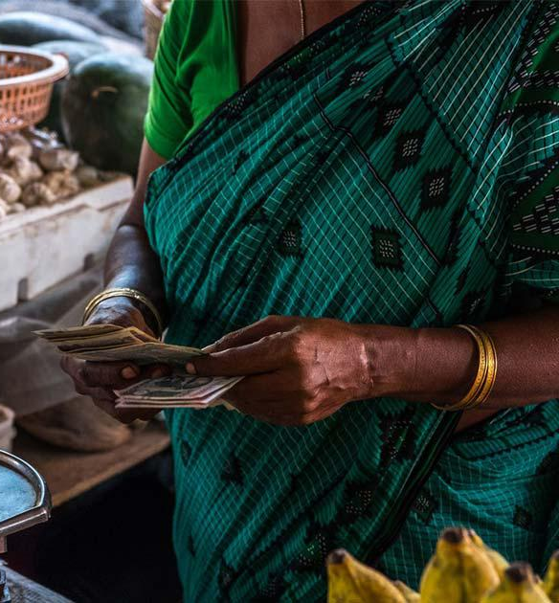
CREDIT
SAVINGS
INSURANCE
POINTS

Slide 6
What should we be doing?
Looking forward - key trends
Enhancing customer value
Diversification of the financial services landscape
Complex regulatory frameworks
Expansion of the mobile money value proposition

Slide 7
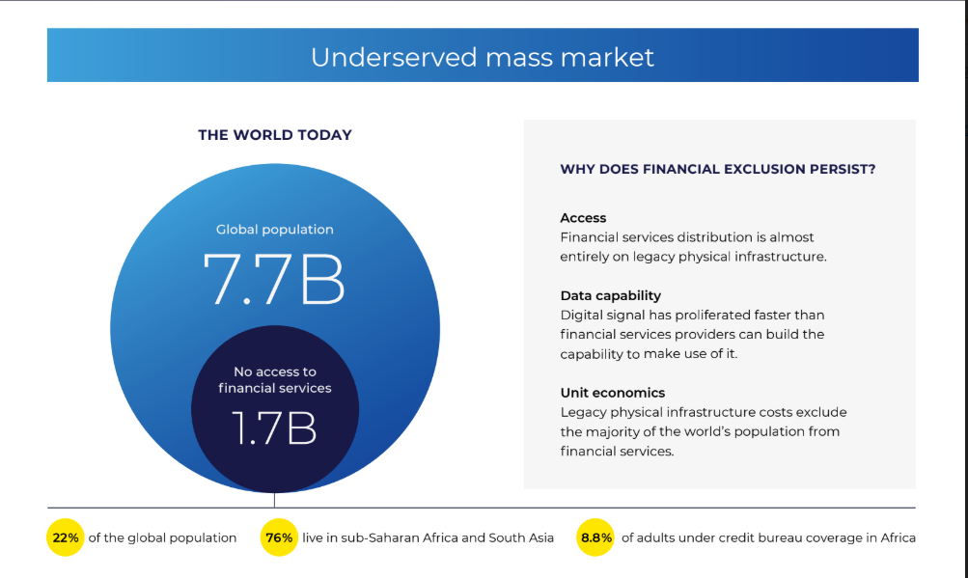
The Opportunity

Slide 8

Notes:
Image treatment without text

Slide 9


